Slide 1
Gesture Control Virtual Mouse

Slide 2
Outline
Aim of the Project
Motivation of Project
Abstract of Project
Software Requirements and Libraries Used

Slide 3
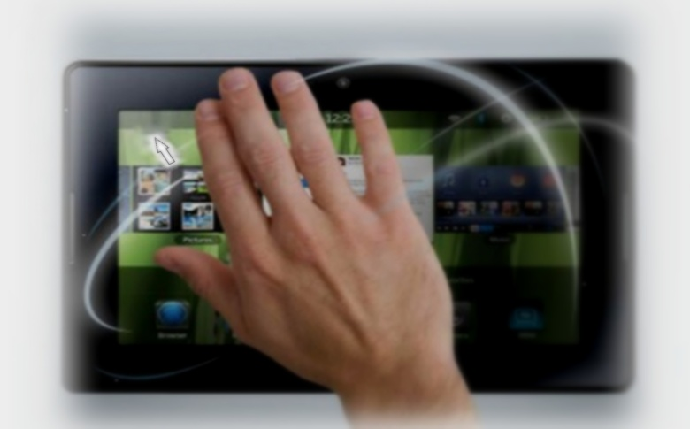
Aim
The goal is to manage computers and other devices with gestures rather than pointing and clicking a mouse or touching a display directly.

Slide 4
Motivation of the Project
The main advantage of using hand gestures is to interact with computer as a non-contact human computer input modality
Reduce hardware cost by eliminating use of mouse.
The framework may be useful for controlling different types of games and other applications dependent on the controlled through user defined gestures.

Slide 5
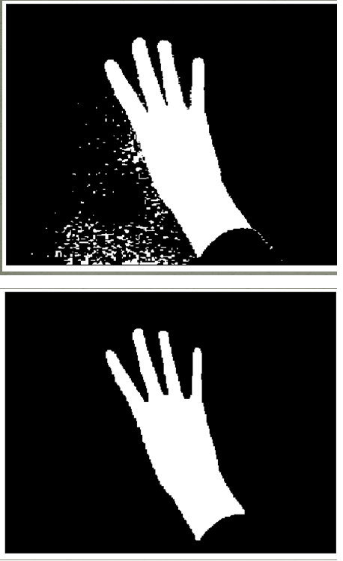
Abstract
This project presents an approach to develop a real-time hand gesture
recognition based in ―”Vision Based”that uses only built-in-camera and
Computer Vision technology, such as image processing that can acknowledge
Many gestures for use in computer human interaction.
The application of real time hand-gesture recognition in the real world
are countless, due to the fact that it can be used almost anywhere where we
interact with computers. The Principle application of this project is to imitate
the mouse as a visual inputting device with all of its tasks such as left click,
selecting, curser moving and scroll.

Slide 6
Software Requirements and Libraries
Operating System :-Windows
Coding Language :-Python
Software :- Python IDE’S
Google Collab
MS Excel
Libraries :-Cv2,Mediapipe,Numpy,Autopy,Pyautogui

Slide 7
Thank You!

